Slide 1

MINHUB
Your one-stop service for all NFT creators.

Slide 2

INTRODUCTION
MinHub is a one-stop service for all NFT creators. MinHub allows you to generate and deploy a ERC721 contract on the Mantle blockchain with any information and features. After the deployment, you can use mint button for integration, with which anyone can mint your NFT collection.
We saw how rapidly the NFT community on the Mantle blockchain is developing and decided to release MinHub on Mantle to make it easier for creators to go from the idea of a collection to its implementation.

Slide 3
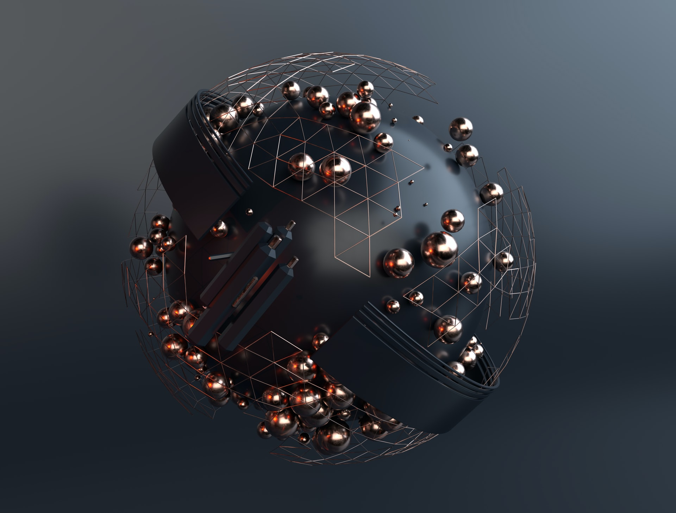
What MinHub is meant to do
Traditionally, creating an NFT involves writing code or using complex software to generate a unique token that represents a digital asset. This can be a barrier to entry for many people who are interested in participating in the NFT market but lack the technical skills or resources to create NFTs themselves.
MinHub would remove this barrier by providing an easy-to-use interface that allows users to create NFTs without any coding knowledge. This would democratize the NFT market and open it up to a wider range of creators and collectors.
In addition to simplifying the creation of NFTs, MinHub would also improve the overall user experience of the NFT ecosystem. By making it easier for people to create and trade NFTs, more people may be incentivized to participate in the market. This could lead to increased liquidity and more diverse offerings, which could attract even more participants.

Slide 4

Features
Mantle Blockchain
01
One of the leading blockchains. High efficiency along with low commissions.
ERC721 contracts
02
Own everything
MinHub supports Mantle ERC721 contract generation. Create efficient and purpose built contracts for your project in a few minutes.
05
With MinHub you own everything. From contract to IPFS to mint button - your project is totally decentralized.
Easy deployments
Analytics
03
06
No delay or confusion, click a single button and be live in one minute.
Get detailed metrics about who mints and owns your collection and recommendations on how to scale better.
Built for all
Free for all
04
07
Create collections of 100 or 10,000. Umbre provides you all the tools for a perfect launch.
MinHub is open for all. No payment upfront. No email signup. Just connect your wallet and launch.

Slide 5



List Them For Sale
60 BIT
80 BIT
150 BIT

Slide 6
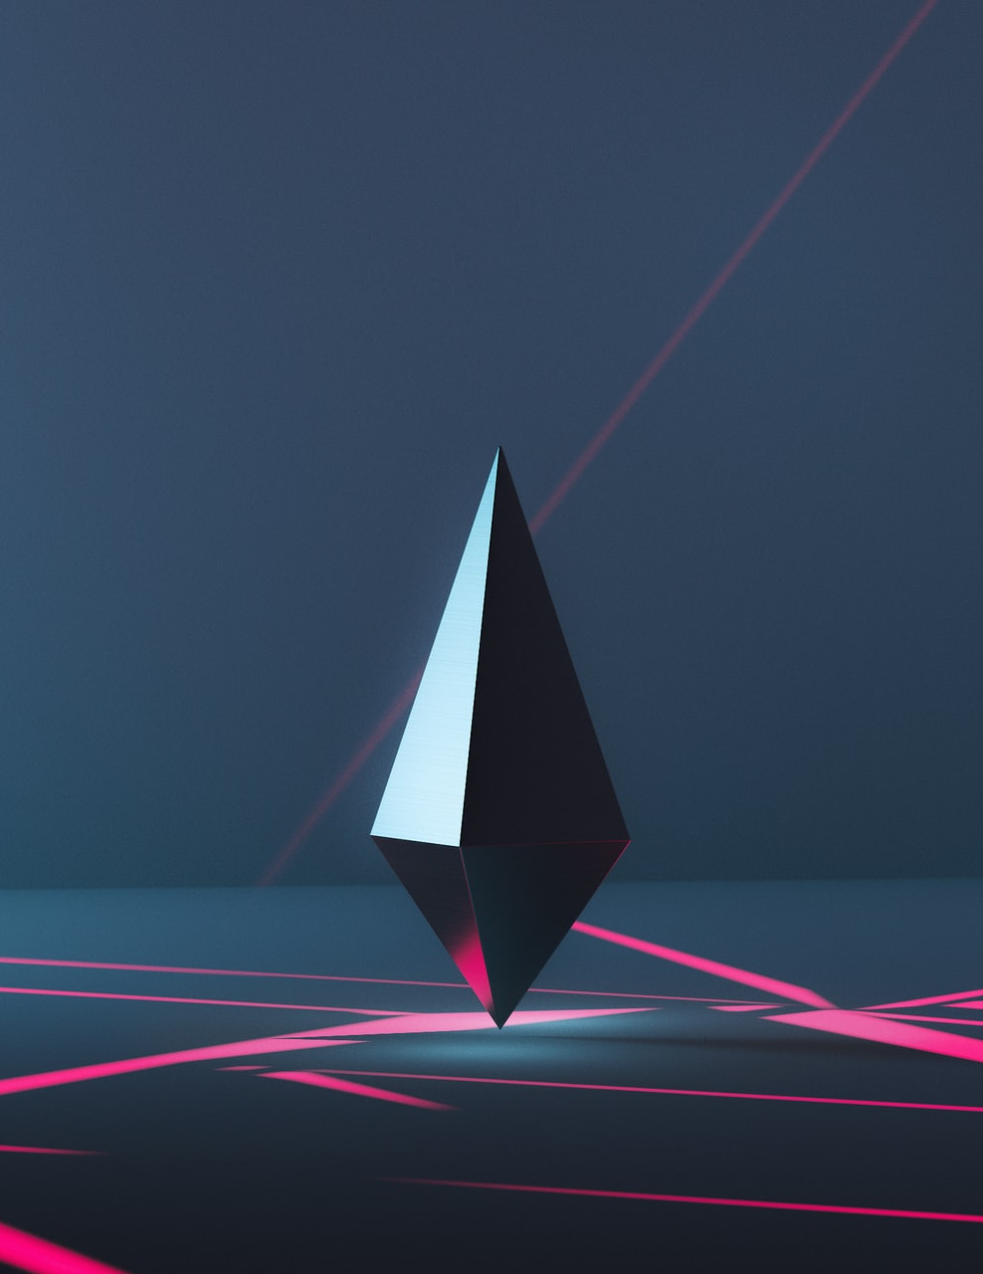
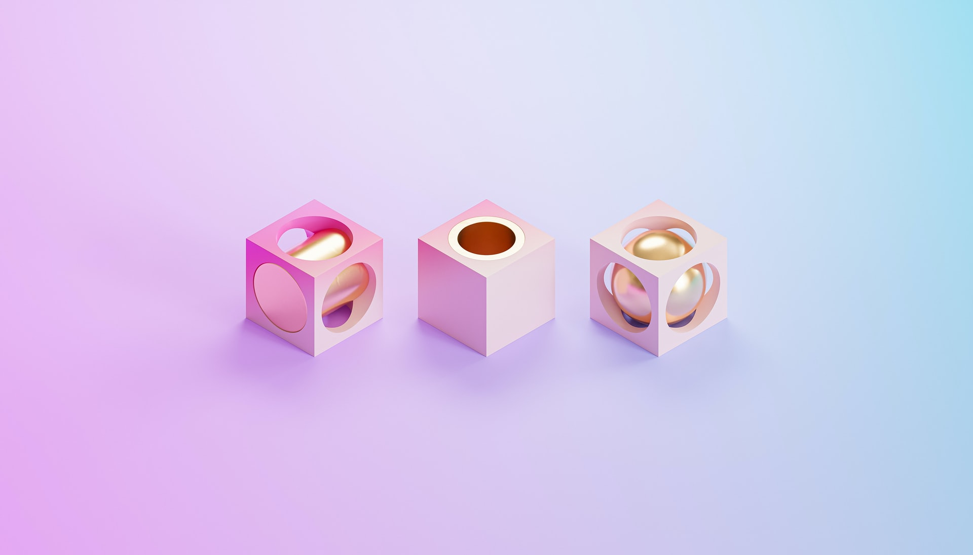
Fresh Collections

Slide 7


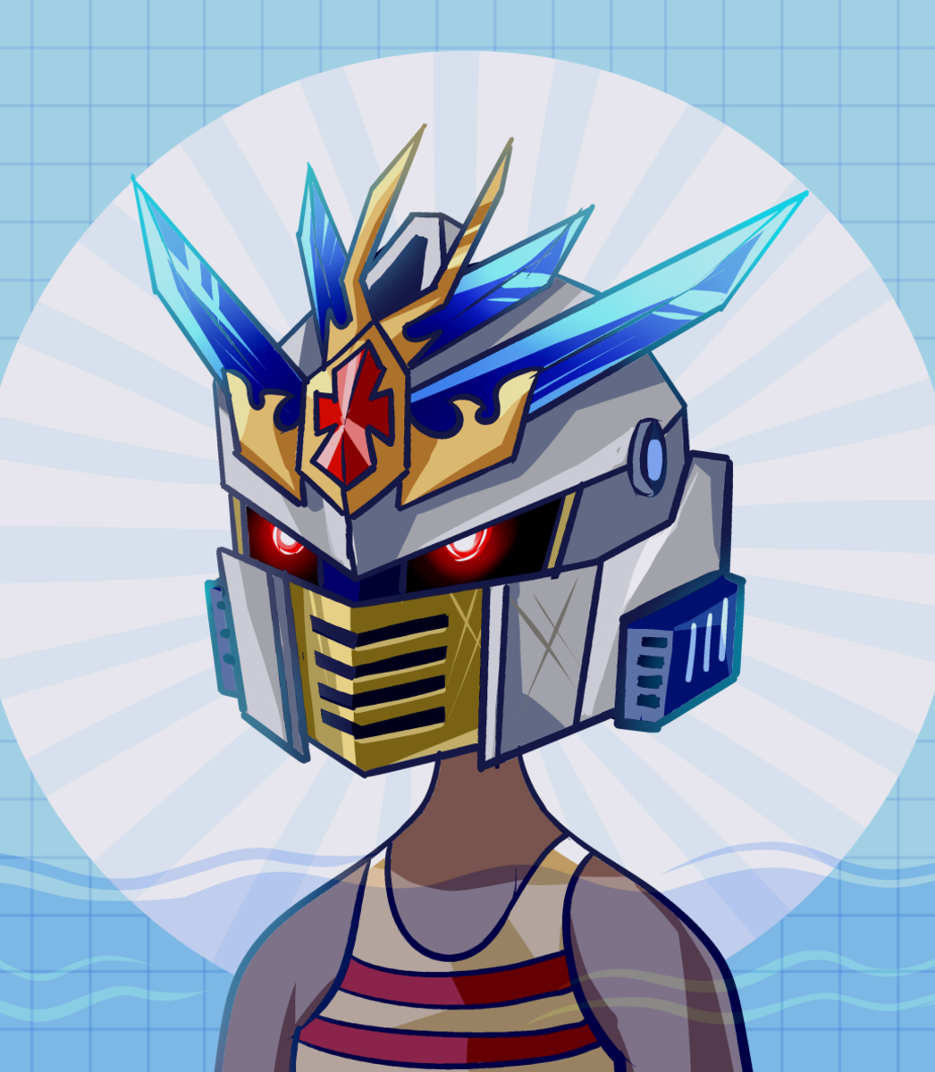
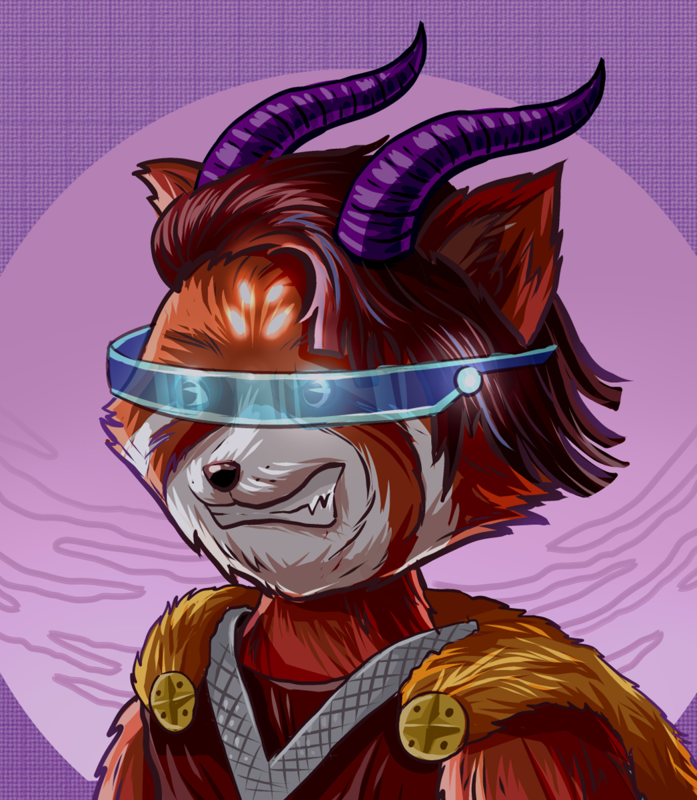
Thank You !

